Slide 1

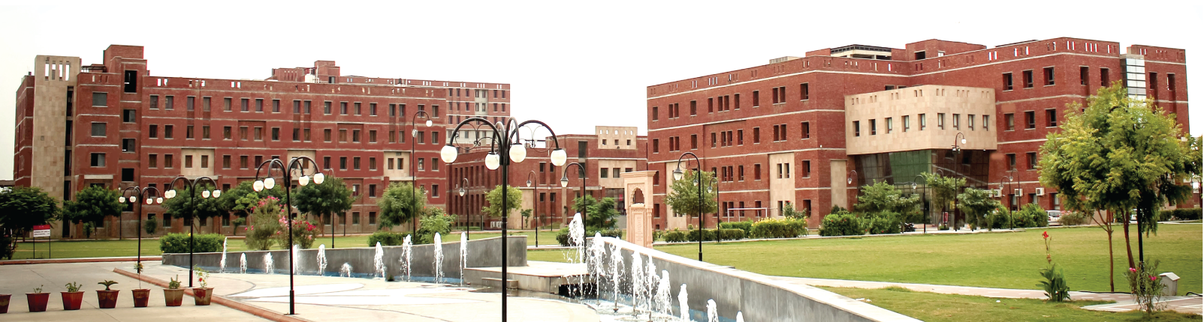
DEPARTMENT OF
Computer Science and Engineering
Major Project Presentation
On
“DigiMitra”
AI-Powered Digital Transformation Platform for Local Micro-Businesses
Presented By:-
Chahat Modi
23BCON0775
Guide:-
Gaurav Kumar Sharma
Assistant Professor
2025-2026

Slide 2
Contents
Introduction
Problem Statement
Objectives
Literature Review
Functional Requirements
Non-Funtional Requirements
System Architecture
Data Flow Diagram
ER Diagram
Methodoology
Sentiment Analysis Logic

Slide 3
Algorithm & SQL Mapping
Tools & Technologies
Project Modules
Testing & Verification
Results & Output
Roles & Responsibilities
Conclusion & Future Scope
References

Slide 4
Introduction
Core Problem
Small shopkeepers often do not know which digital tools they actually need
Expensive websites and digital services may not be suitable for them
Many businesses have limited technical knowledge
Existing platforms usually provide one specific service
There is a need for simple and affordable digital guidance
Background
Increasing use of UPI and online platforms
Local businesses need better digital visibility
Many micro-businesses still depend mainly on offline customers
Digital transformation can improve customer reach
Motivation :
“The problem is not only lack of technology — it is lack of the right technology at the right cost.”
DigiMitra

Slide 5
Problem Statement
Existing Problems
Small businesses have limited budgets
Owners may not understand technical terms
They often don't know whether they need:
  Website
  Google Business Profile
  WhatsApp Business
  Digital catalogue
  Online ordering
Existing tools usually solve only one problem
Professional digital consultants can be expensive
Need
A simple system that first understands the business and then recommends what should be done.
The original framework identifies this as an information-asymmetry problem: merchants may not know what technology they actually need.

Slide 6
Objectives
01
02
Measure the digital readiness of a small business
Identify the major digital gaps
03
04
Recommend suitable digital tools
Consider the owner's available budget
05
06
Generate a simple step-by-step roadmap
Provide guidance in simple Hindi/Hinglish
The project's formal objectives include a Digital Readiness Index (0–100) and budget-constrained recommendations

Slide 7
Literature Review
Digital Maturity Models
Existing maturity models are mainly designed for larger organizations.
ME Digital Transformation
Research suggests that small businesses benefit from gradual digital adoption.
01
02
Knapsack Optimization
Knapsack algorithms can help select the best options under a limited budget.
ICT4D
Technology should be designed according to the actual skills and environment of users.
03
04
Research Gap
Existing approaches do not combine digital readiness + budget + technical literacy + personalized recommendations for micro-businesses.
*

Slide 8
Requirements
01
02
Functional Requirements
Non-Functional Requirements
Business registration/profile creation
Business information questionnaire
Digital readiness calculation
Identify digital gaps
Recommend digital interventions
Generate 3-phase roadmap
Provide Hindi/Hinglish explanations
Show suitable service providers
User Friendly
Simple interface for non-technical users
Mobile Friendly
Works properly on mobile devices
Fast Response
Quick scoring and recommendation
Secure
Protects business information
Lightweight
Should work on low-bandwidth connections
Scalable
Can support businesses from different districts

Slide 9
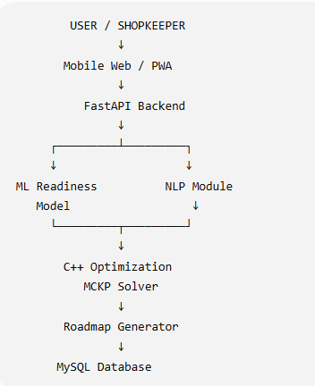
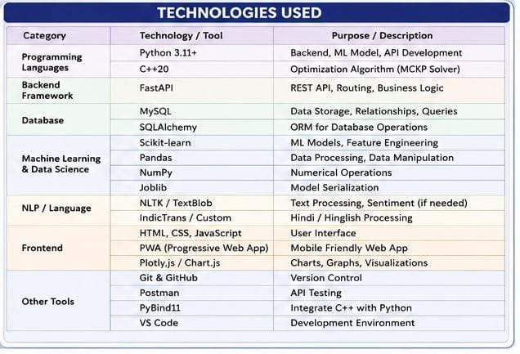
System Architecture

Slide 10
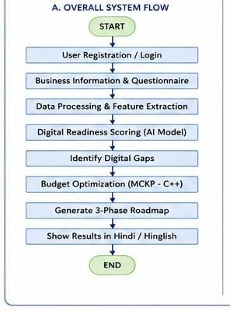
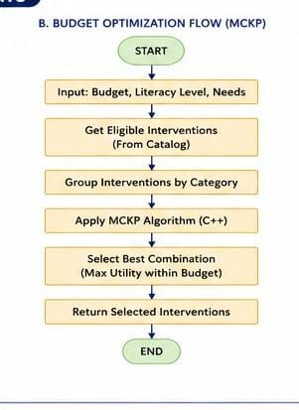
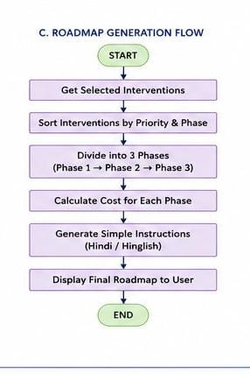
System Architecture & Flow

Slide 11
Data Flow Diagram
Shopkeeper
↓
Business Details
↓
Questionnaire
↓
Feature Processing
↓
Digital Readiness Score
↓
Digital Gap Identification
↓
Budget Optimizer
↓
Recommended Solutions
↓
3-Phase Roadmap
↓
Shopkeeper
Example
Budget: ₹5,000
Readiness: 38/100
↓
System identifies major gaps
↓
Selects suitable interventions
↓
Generates:
Phase 1 → ₹0
Phase 2 → ₹1,500
Phase 3 → ₹3,500

Slide 12
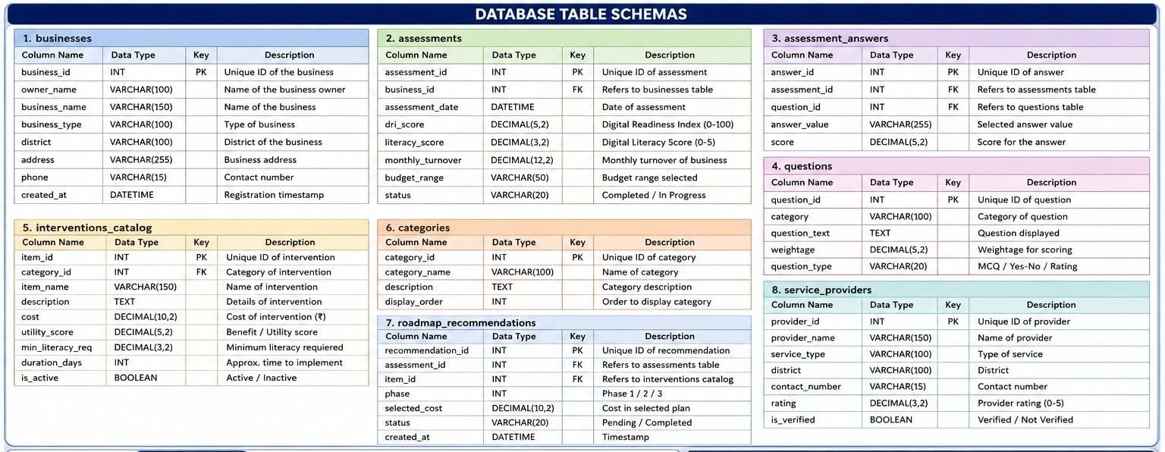
Database Schemas

Slide 13
Methodology
Approach Used
01 — Data Collection
Collect information from local businesses through a questionnaire.
↓
02 — Data Processing
Convert answers into numerical/categorical features.
↓
03 — Readiness Assessment
ML model calculates the Digital Readiness Index.
↓
04 — Gap Identification
Find areas where the business needs digital improvement.
↓
05 — Budget Optimization
C++ algorithm selects the best combination of solutions.
↓
06 — Roadmap Generation
Solutions are arranged into different phases.
↓
07 — User Display
Simple Hindi/Hinglish explanation is shown.

Slide 14
Digital Readiness Logic
Digital Readiness Assessment
The system asks questions related to:
Digital payments
Online presence
WhatsApp usage
Product catalogue
Digital marketing
Technical confidence
Business goals
These answers are converted into features.
Output
Digital Readiness Index
0 ───── 25 ───── 50 ───── 75 ───── 100
Low Basic Developing Advanced
Example:
DRI = 38.2 / 100
→ Foundational Digital Readiness
Your framework defines the DRI as a standardized score between 0 and 100.

Slide 15
Optimization Algorithm
Multiple-Choice Knapsack Problem
Available options:
Solution | Cost | Benefit
Google Profile | ₹0 | High
WhatsApp Catalogue | ₹0 | High
Digital Catalogue | ₹1,500 | Medium
Website | ₹3,500 | High
SEO | ₹2,000 | Medium
Suppose the shopkeeper has:
Budget = ₹5,000
The formal framework uses Dynamic Programming for the MCKP solver
The algorithm selects the best combination within ₹5,000.
Simple Logic
Maximum Business Benefit + Limited Budget + Literacy Requirement

Slide 16
Algorithm & SQL Mapping
Optimization Logic
SQL Example
Input:
Budget
Business Needs
Literacy Level
Available Solutions
↓
Check eligible solutions
↓
Compare Cost + Utility
↓
Select Best Combination
↓
Generate Roadmap
SELECT item_id, tier_name, cost, utility_score
FROM interventions_catalog
WHERE category_id = :cat_id
AND min_literacy_req <= :user_literacy;

Slide 17
Tools & Technologies
Software & Programming
Python 3.11+
ML + Backend
C++20
Optimization Algorithm
MySQL
Database
Frameworks & Libraries
FastAPI
Scikit-learn
Pandas
NumPy
TextBlob / NLTK
SQLAlchemy
pybind11
Hardware Requirements
Intel i5 / Ryzen 5 or above
8GB–16GB RAM
256GB SSD or higher
Frontend
HTML
CSS
JavaScript
PWA
Plotly.js
Development Tools
VS Code
Git & GitHub

Slide 18
Implementation / Project Modules
Modules Developed
Module 1 — Business Data Collection
Collects and processes business information.
Module 2 — Readiness Assessment
Calculates the Digital Readiness Index.
Module 3 — Budget Optimizer
Finds the best solutions according to budget.
Module 4 — Roadmap Generator
Creates a simple 3-phase digital roadmap.
Module 5 — District Analytics
Shows aggregated digital readiness trends.
These are the five modules defined in the framework
Model will be evaluated using MAE and R².

Slide 19
Testing & Verification
01 — Unit Testing
Test FastAPI endpoints and database operations.
02 — ML Testing
Check model prediction accuracy.
03 — Algorithm Testing
Check whether selected solutions remain within budget.
04 — Integration Testing
Check communication between:
Frontend → API → ML → C++ → Database
05 — Performance Testing
Measure response time.
Your framework proposes unit, model, algorithm and performance testing.

Slide 20
Results & Output
DIGIMITRA ASSESSMENT
Business: Sharma Handicrafts
Digital Readiness: 38.2 / 100
Readiness Level: Foundational
Budget: ₹5,000
Literacy Index: 2.3 / 5
Recommended Roadmap
Phase 1 — ₹0
Google Business Profile
WhatsApp Business
UPI QR
Phase 2 — ₹1,500
Digital Catalogue
Local SEO
Phase 3 — ₹3,500
Bilingual Landing Page
WhatsApp Ordering
Total = ₹5,000

Slide 21
Roles & Responsibilities
Roles & Responsibilities
Team Member Name: Chahat Modi
Research & problem identification
Dataset/questionnaire preparation
ML model development
C++ optimization algorithm
Backend development
MySQL database
Frontend/PWA development
Testing & debugging
Documentation & presentation

Slide 22
Conclusion
DigiMitra helps small businesses understand their digital needs
It measures their current digital readiness
It considers their budget and technical ability
It recommends suitable digital solutions
It provides a simple step-by-step roadmap
It combines AI + Optimization + Web Technology + Database
Core Idea
“Don't sell technology to the business. First understand the business, then recommend the right technology.”

Slide 23
Limitations & Future Scope
01
02
Limitations
Future Enhancements
Initial dataset may be limited
Recommendations depend on survey responses
ML performance improves with more real-world data
Vernacular NLP may have limitations
Voice-based assistant
More regional languages
ONDC integration
Local service-provider marketplace
Advanced business prediction

Slide 24
References
Mittal et al. (2018) — Digital maturity models and SMEs
Garzoni et al. (2020) — Digital transformation in SMEs
Kellerer, Pferschy & Pisinger (2004) — Knapsack Problems
Heeks (2002) — Information Systems and Developing Countries

Slide 25
THANK YOU
Open for discussion
DigiMitra
AI-Powered Digital Transformation for Local Businesses
Open for Discussion

